Slide 1

LIME Garcon
Serving you the numbers you care about

Slide 2
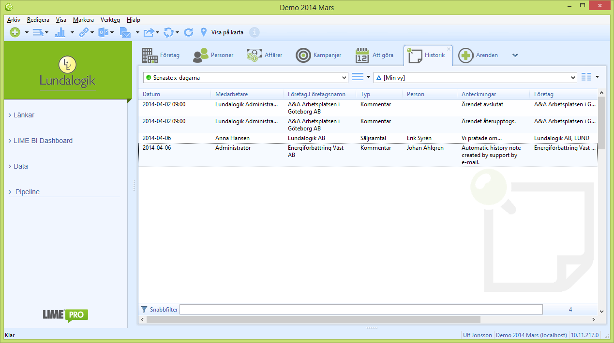
TODAY
Searching for the numbers you care about
2. Select filter
1. Select tab

Slide 3





LIME Garcon
Serving you the numbers you care about

Slide 4
LIME Garcon
Serving you the numbers you care about

Slide 5
LIME Garcon
Serving you the numbers you care about
WHO’S THIS FOR?
EVERYONE!
We truly mean it!

Slide 6
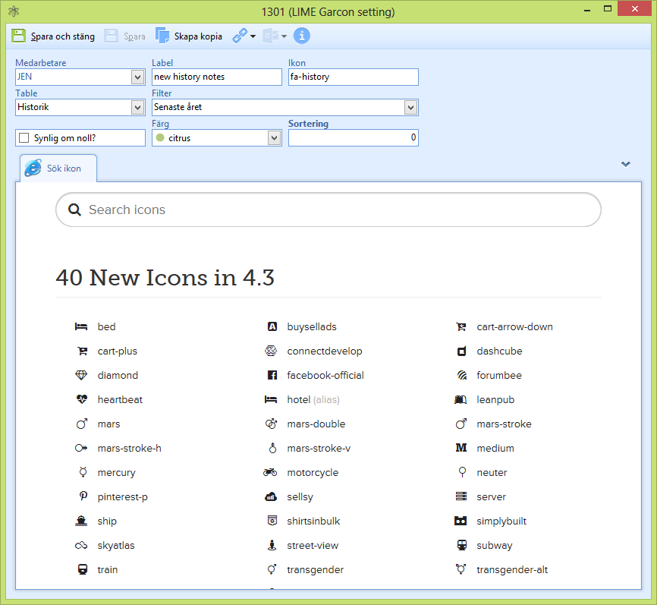
LIME Garcon
Serving you the numbers you care about

